Slide 1
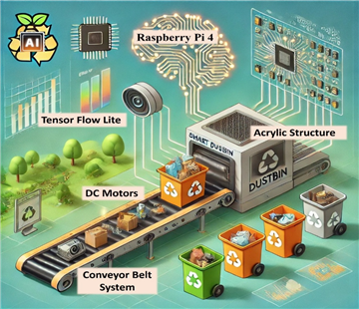
📲Fitnorish.Ai
🤷‍♂️Problem
People do not know how many calories and nutrients they need daily
Users with diabetes and hypertension need personalized diets, not generic plans
Grocery prices change across stores, making healthy choices expensive
Health data is hard to track manually and often inaccurate
🧠Impact
Poor diet leads to obesity, diabetes, heart disease, and high medical costs
People spend more money without nutrition awareness
Lack of early health alerts increases long-term health risks

Slide 2

📲Fitnorish.Ai
👥 Who Is Affected
Individuals managing weight (lose / gain / maintain)
People with chronic diseases (diabetes, hypertension)
Busy students and professionals
Families trying to eat healthy on a budget
💪Who Benefits
Users get personalized nutrition guidance
Healthcare providers get better health insights
Society benefits from preventive healthcare
Technology sector benefits from AI + ML + mobile integration

Slide 3
📲Fitnorish.Ai
Design Excellence of the Solution
Smart & Intelligent Design
Collects health, activity, and lifestyle data
Uses Machine Learning to predict:
Daily calories
Protein, carbs, and fat needs
Supports multi-disease nutrition planning
Cost & Meal Intelligence
Compares grocery prices across stores
Suggests cheaper nutrition-equivalent alternatives
Analyzes meal images to estimate calories and nutrients
Technical Strength
Mobile-first, user-friendly UI
Backend: FastAPI, ML models, PostgreSQL
Ready for smartwatch and wearable integration
Supports multi-disease awareness
(diabetes & hypertension)
Rule-based + ML hybrid approach improves
reliability and explainability
Scalable architecture suitable for adding new health conditions and features
Local and Sri Lanka–context aware design (nutrition and lifestyle suitability)

Slide 4

IT22907684 |Weerarathne H.P
​ AI-powered Multi-Disease Adaptive Nutrition and Personalized Health Optimization​
BSc (Hons) in Information Technology Specialization in Information Technology​
IT22907684 | Weerarathne H.P | 25-26J-386

Slide 5
​ AI-powered Multi-Disease Adaptive Nutrition and Personalized Health Optimization​
​ AI-powered Multi-Disease Adaptive Nutrition and Personalized Health Optimization​
🔹 How the Solution will Address the Sub-Problem / Prototype
Many users do not know how many calories they need per day
Most apps give same values for everyone and do not consider health problems
This solution calculates daily calorie needs using the user’s body details
It also calculates protein, carbohydrates, and fat needs
The system uses phone activity data (steps and active calories)
A smartwatch snapshot is used to check stress and heart rate for safety
The solution changes results if the user has diabetes or hypertension
👉 The prototype shows how user inputs are converted into clear nutrition values.
🔹 User Requirements Addressed by the Solution
Users can enter basic personal details easily​
Users with health conditions can safely use the system​
Daily activity is automatically considered using Smart watch data​
Users do not need to manually calculate calories​
Results are shown in simple numbers (kcal, grams of protein, carbs, fat)​
The system avoids giving unsafe recommendations​
IT22907684 | Weerarathne H.P | 25-26J-386

Slide 6
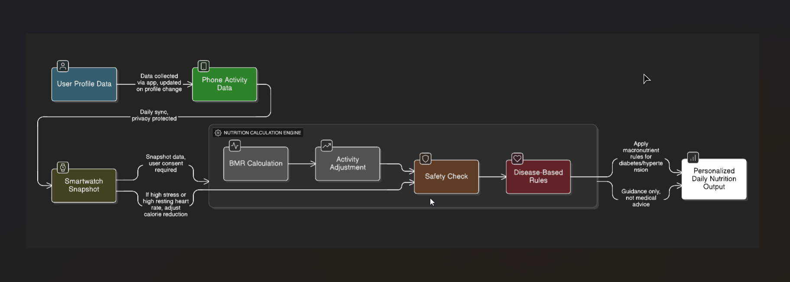
​ AI-powered Multi-Disease Adaptive Nutrition and Personalized Health Optimization​
​ AI-powered Multi-Disease Adaptive Nutrition and Personalized Health Optimization​
IT22907684 | Weerarathne H.P | 25-26J-386

Slide 7
​ AI-powered Multi-Disease Adaptive Nutrition and Personalized Health Optimization​
🔹 Design Excellence / Individual Contribution
Designed a step-by-step calculation method that is easy to explain
Used scientific formulas instead of guessing values
Added health-condition-based rules for better accuracy
Used fixed percentages so results are consistent and reliable
Added safety checks using smartwatch stress and heart rate
Collect a realistic Sri Lankan dataset for testing and learning
👉 This makes the system reliable, safe, and explainable.
🔹 User Requirements Addressed by the Solution
Users said the results are easy to understand
Users liked that health problems are considered
Users found smart watch -based activity tracking very useful
Users suggested adding Sinhala language support
IT22907684 | Weerarathne H.P | 25-26J-386

Slide 8

IT22343352 | Ekanayake M Y R
AI-powered Dynamic Meal Generator and Visual Ingredient Identifier
BSc (Hons) in Information Technology Specialization in Information Technology
IT22343352 | Ekanayake M.Y.R| 25-26J-386

Slide 9
AI-powered Dynamic Meal Generator and Visual Ingredient Identifier
How the Solution will Address the Sub-Problem / Prototype
Instant meal analysis from meal images.
Generate personalized meal planning.
AI-powered.
Health-focused customization.
User Requirements Addressed by the Solution
Personalized nutrition guidance
Real-time food analysis and tracking.
Intelligent meal planning with optimization.
Accessible & User-Friendly UI
IT22343352 | Ekanayake M.Y.R| 25-26J-386

Slide 10
AI-powered Dynamic Meal Generator and Visual Ingredient Identifier
Design Excellence / Individual Contribution
Designed a simple and user-friendly food analyser interface.
Displayed ingredient, nutrition and calorie information and meal plan clearly.
Optimized AI integration.
Robust error handling.
User Feedback on Prototype
Image-based food identification is easy and time-saving.
Nutrition and calorie display is clear.
Meal suggestions help users make better food choices.
UI and performance improvements will be addressed in future versions.
IT22343352 | Ekanayake M.Y.R| 25-26J-386

Slide 11

IT22343420 | T.M. Poornima
AI-Powered Predictive Health Alert and Progress Tracking System
BSc (Hons) in Information Technology Specialization in Information Technology

Slide 12
AI-Powered Predictive Health Alert and Progress Tracking System
How the Solution will Address the Sub-Problem / Prototype
Collects real-time health data from wearable devices and user profile (activity, BP, sleep).
Stores and analyzes daily health data (latest).
Tracks health trends (daily, weekly, monthly).
Uses ML-based analysis to predict health risk levels (Low / Medium / High).
Predict personalized diet recommendations and health guidance.
Provides time-based health alerts and reminders.
User Requirements Addressed by the Solution
Automatic and manual health data collection with minimal user effort.
Clear visualization of health progress and trends.
Early identification of potential health risks.
Personalized diet and lifestyle recommendations.
Timely alerts to encourage healthy behavior.
IT22343420 | T.M. Poornima | 25-26J-386

Slide 13
AI-Powered Predictive Health Alert and Progress Tracking System
Design Excellence / Individual Contribution
Wearable data integration and structured health data management.
Health trend analysis using historical data.
Risk prediction based on vital signs and lifestyle factors.
Prediction of diet recommendation.
Time-based alert system for diet and health actions.
Simple and easy-to-understand health dashboards.
User Feedback on Prototype
Health progress tracking is clear and informative.
Risk level indication helps users understand their health status.
Diet recommendations are practical and easy to follow.
Alerts are helpful for maintaining daily healthy habits.
IT22343420 | T.M. Poornima | 25-26J-386

Slide 14
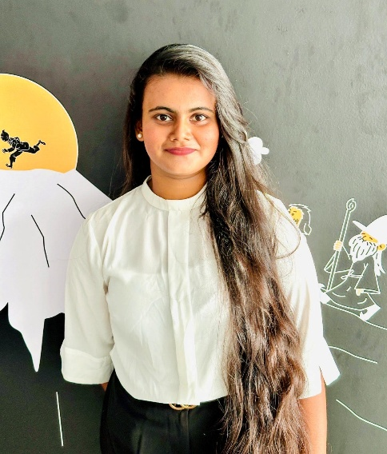
IT22343284 | SAMARAWICKRAMA T.N
AI-powered Smart Grocery List Optimization and Nearest Store Recommendation
BSc (Hons) in Information Technology Specialization in Information Technology

Slide 15
AI-Powered Predictive Health Alert and Progress Tracking System
How the Solution will Address the Sub-Problem / Prototype
Solves the problem of finding the cheapest and nearest grocery store using real supermarket data.
Uses real-time supermarket data scraped from Keells (API-based Curl ) and Cargills (browser-based scraping using Playwright).
Implements a structured data pipeline that transforms raw supermarket data into clean, categorized, and nutrition-ready product information.
The prototype recommends the best store based on price and distance and suggests cheaper nutrition-equivalent alternatives when the user’s budget is exceeded.
User Requirements Addressed by the Solution
Helps users identify the cheapest grocery store for their shopping list.
Allows users to stay within a given budget while purchasing essential items.
Considers the user’s current location to reduce unnecessary travel distance.
Provides cheaper nutrition-equivalent alternatives when preferred items exceed the available budget.
IT22343284 | Samarawickrama T.N | 25-26J-386

Slide 16
AI-Powered Predictive Health Alert and Progress Tracking System
Design Excellence / Individual Contribution
Introduces a structured and scalable data pipeline.
Applied rule-based L1–L2 product categorization to achieve transparent and explainable classification, suitable for audit and analysis.
Introduced versioned categorization (taxonomy_version, model_version) to support reclassification, experimentation, and future ML integration.
Structured the system to support machine-learning-based categorization, where rule-based labels act as training data for future ML models.
User Feedback on Prototype
Users found the interface easy to understand and navigate, even without technical knowledge.
The price comparison and store recommendation features were perceived as useful for saving money.
Budget alerts and substitution suggestions helped users make more informed purchasing decisions
Nutrition-based substitution was identified as a unique and valuable feature compared to standard grocery comparison tools.
IT22343284 | Samarawickrama T.N | 25-26J-386

Slide 17
💵Commercialization Potential
Customer Persona
Individuals (25–65) with multiple chronic diseases
Health-conscious users with smartphones and wearables
Clinics, corporate wellness programs, insurance companies, and health NGOs
Market Size
Over 1 million potential users in the region
Targeting 10% penetration ensures strong adoption and scalability
What Is Unique (USP)
First solution offering safe, adaptive, and explainable nutrition guidance for multi-disease users
Uses real-time health data for personalized recommendations
Revenue & Cost Recovery
B2C: Subscription-based mobile app(users & supermarket chains)
B2B2C: SaaS licensing to clinics, corporates, and insurers
Costs can be recovered within months through subscriptions and partnerships
IT22907684 | Weerarathne H.P | 25-26J-386

Slide 18
Thank You !

